Slide 1
Minimizing Cache Usage in Paging
Alejandro López-Ortiz , Alejandro Salinger
University of Waterloo

Slide 2
Outline
Paging
Paging with cache usage
Interval Scheduling
Online algorithms
Simulations
Conclusions

Slide 3

Paging
Slow memory
Cache of size k
Page requests
…p₆ p₃ p₂ p₄ p₄ p₂ p₁₀ p₁₁ p₅ p₄…
Is p_{i} in the cache?
-Yes
Hit
Fault
-No
Fetch p_{i} from slow memory,
evict one page from cache
Traditional cost model
Hit: 0
Fault: 1
Goal: minimize number of faults

Slide 4
Paging
Common eviction policies:
  Least Recently Used (LRU)
  First In First Out (FIFO)
  Flush When Full (FWF)
  Furthest In The Future (FITF) (offline)
Marking and conservative algorithms are k-competitive

Slide 5
Paging with Cache Usage

Slide 6
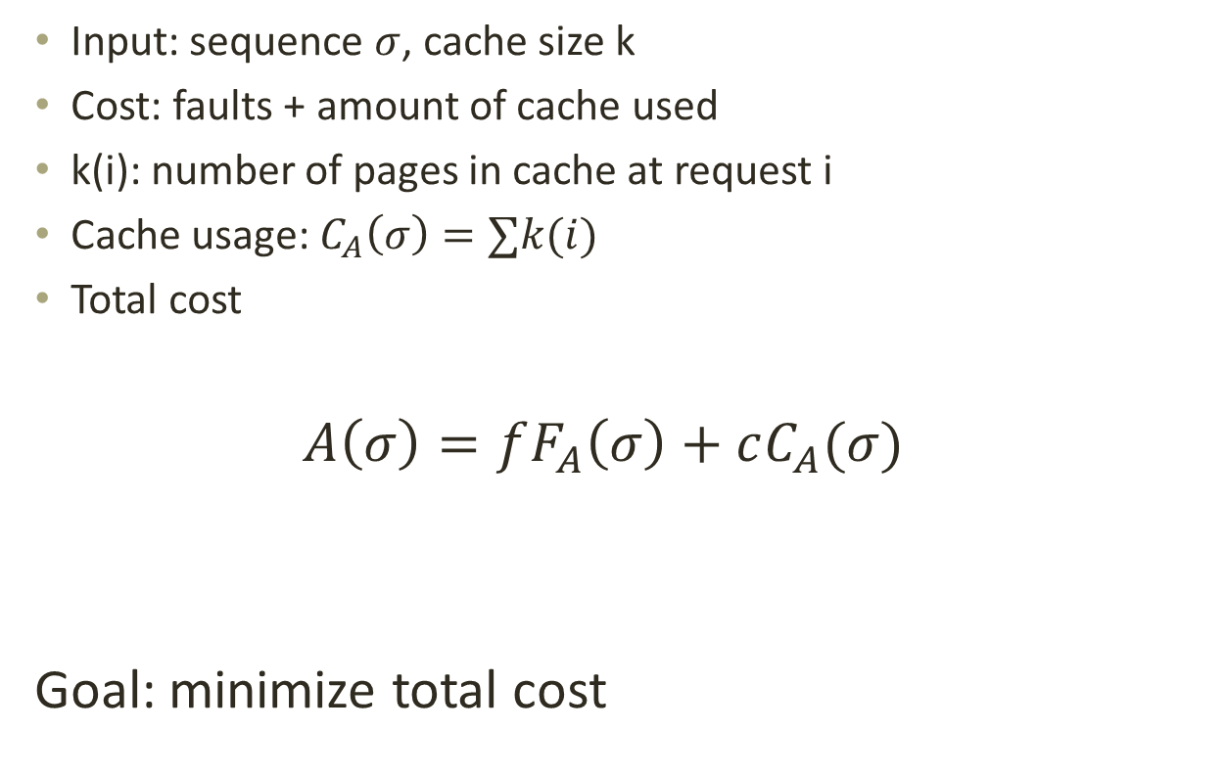
Paging with Cache Usage
Input: sequence $σ$, cache size k
Cost: faults + amount of cache used
k(i): number of pages in cache at request i
Cache usage: $C_{A}\left(σ\right)=∑k(i)$
Total cost
$$A\left(σ\right)=fF_{A}\left(σ\right)+cC_{A}(σ)$$
Goal: minimize total cost
fault cost
cell cost

Slide 7
Applications
Shared cache multiprocessors

Slide 8
Applications
Shared cache multiprocessors
  Cooperative caching

Slide 9
Applications
Energy efficient caching
  Content Addressable Memories (CAMs)
Cache
1
5
8
13
11
3
14
3
7
9
10
15
4
21
17
19
24
18
30
22
2

Slide 10
Applications
Energy efficient caching
  Content Addressable Memories (CAMs)
  Power of search proportional to valid cells
Cache
1
5
8
3
3
7
9
10
15
4
24
30
22
2

Slide 11

Related Cost Models
Full Access Cost [Torng 98]
Hit: 1
Fault:$s≥1$
Coincides with classic model when $s→∞$
Marking algorithms, competitive ratio = $\frac{k\left(s+1\right)}{k+s}$
Captures locality of reference

Slide 12
Related Cost Models
Buying Cache Model [Csirik et al. 01]
Algorithm may purchase cache at cost c(x)
Cost = faults + purchased cache
No limit on purchased cache
No returns

Slide 13
Paging as Interval Scheduling

Slide 14
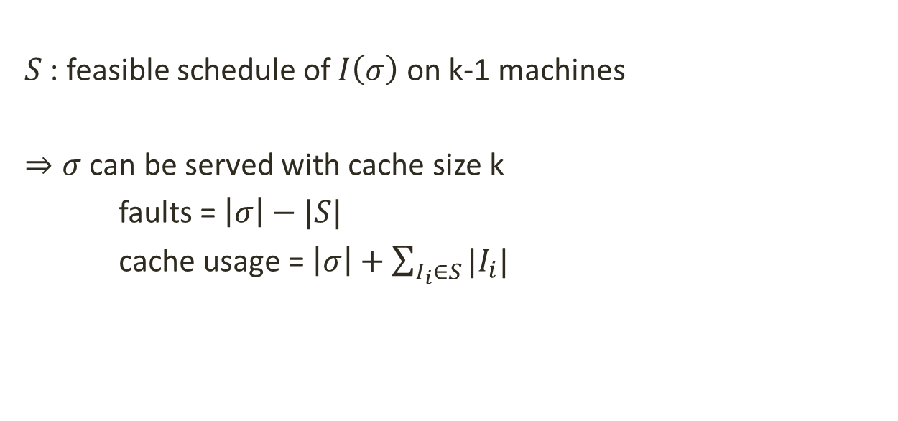

Interval Scheduling
1 | 2 | 3 | 4 | 1 | 1 | 3 | 5 | 2 | 3 | 4 | 5 | 1 | 2
1 | 2 | 3 | 4 | 1 | 1 | 3 | 5 | 2 | 3 | 4 | 5 | 1 | 2
$$I\left(σ\right)$$
$S$ : feasible schedule of $I\left(σ\right)$ on k-1 machines
$⇒σ$ can be served with cache size k
faults = $\left|σ\right|−|S|$
cache usage = $\left|σ\right|+\sum_{I_{i}∈S}{|I_{i}|}$

Slide 15
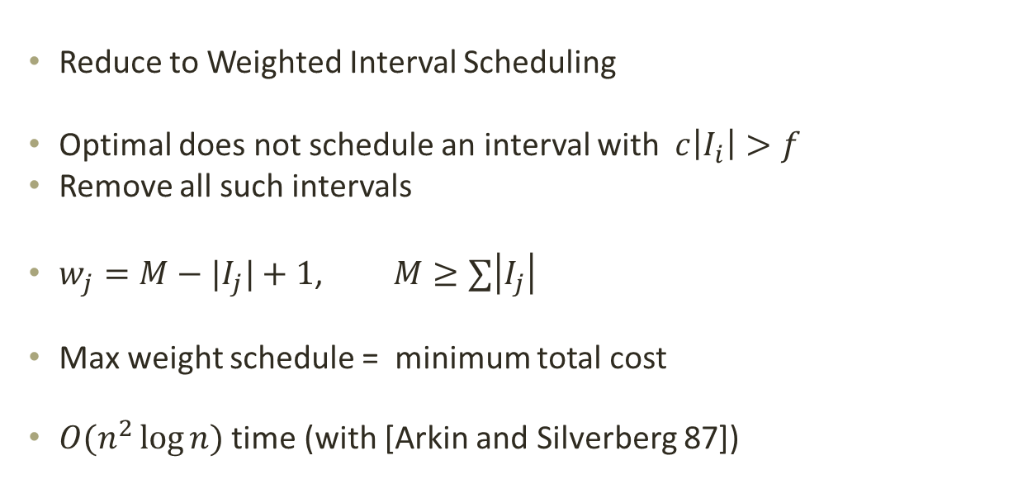
Offline Optimum
1 | 2 | 3 | 4 | 1 | 1 | 3 | 5 | 2 | 3 | 4 | 5 | 1 | 2
Reduce to Weighted Interval Scheduling
Optimal does not schedule an interval with $c\left|I_{i}\right|>f$
Remove all such intervals
$w_{j}=M−|I_{j}|+1$, $M≥∑\left|I_{j}\right|$
Max weight schedule = minimum total cost
$O(n^{2}\log{n})$ time (with [Arkin and Silverberg 87])

Slide 16
Online Algorithms

Slide 17
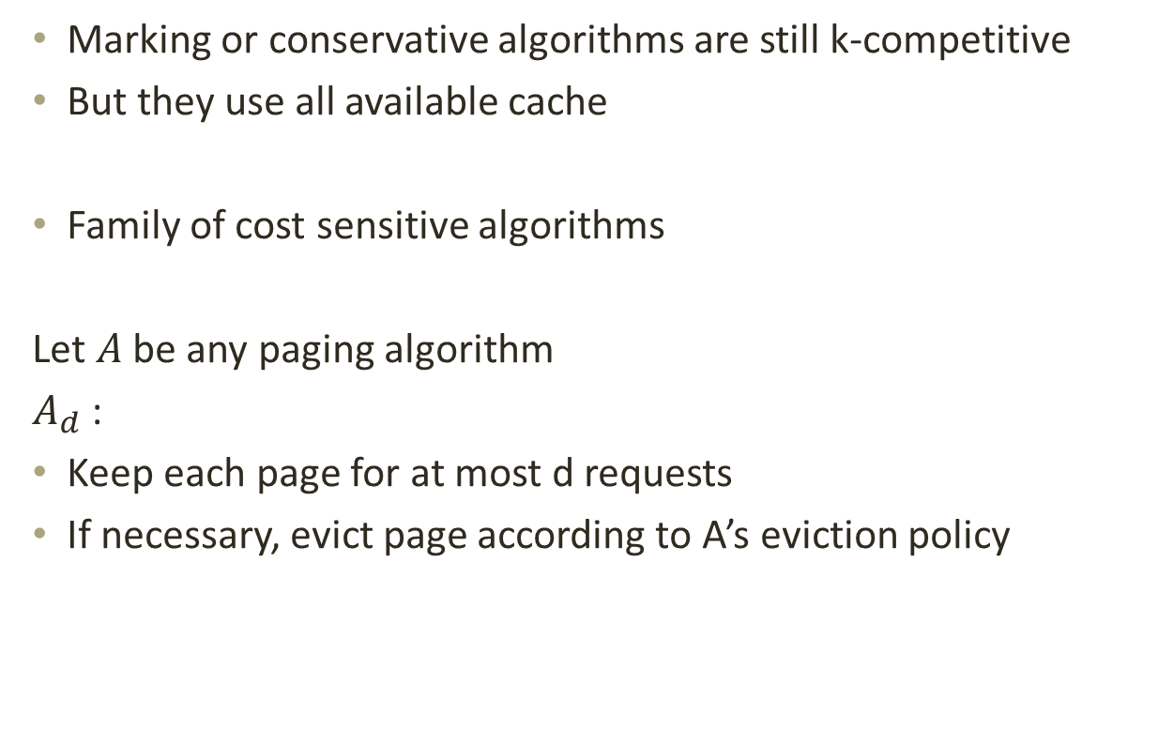
Online Algorithms
Marking or conservative algorithms are still k-competitive
But they use all available cache
Family of cost sensitive algorithms
Let $A$ be any paging algorithm
$A_{d}$ :
Keep each page for at most d requests
If necessary, evict page according to A’s eviction policy

Slide 18
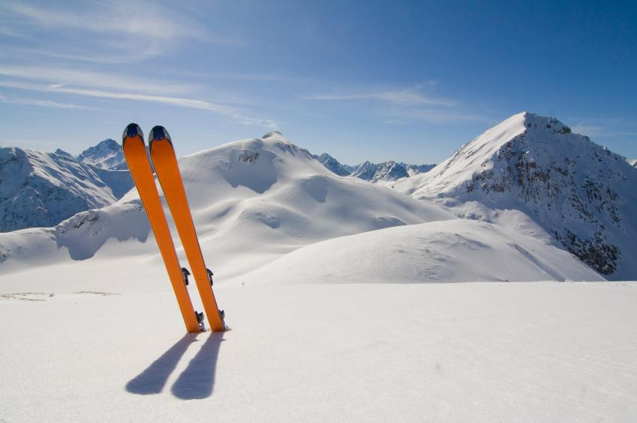
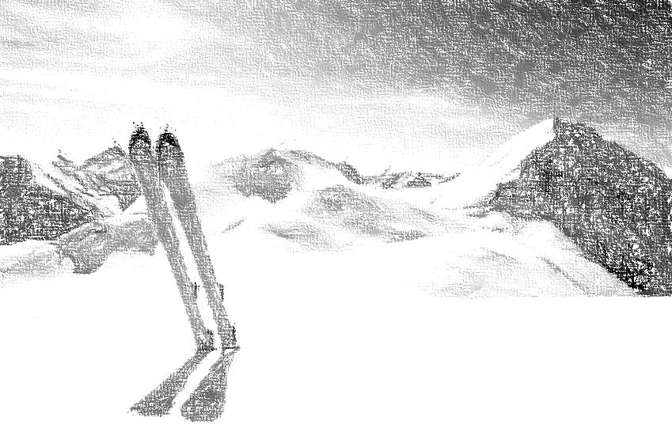



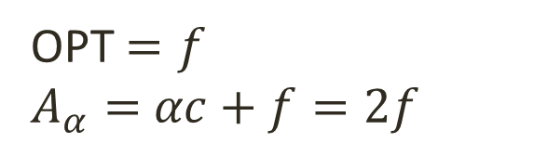

Online Algorithms
A is marking or conservative
What is a good choice for d?
$α=\frac{fault cost}{cache cost}$
Set d = $α$
$A_{α}≤2OPT$ ?
p p
OPT ${=A}_{α}=ℓc$
$ℓ≤α$
p p
OPT $=f$
$A_{α}=$ $αc+f=2f$
$ℓ>α$
Not quite…

Slide 19
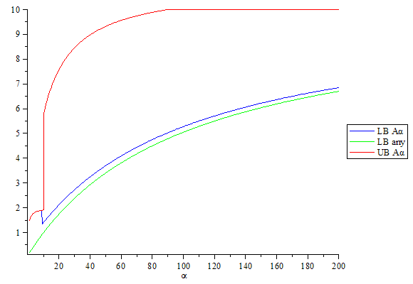
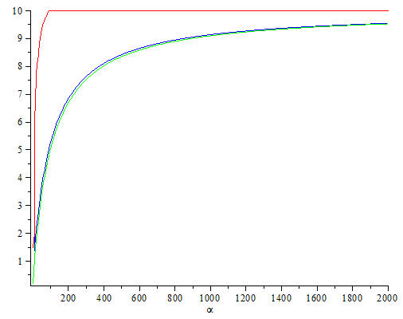

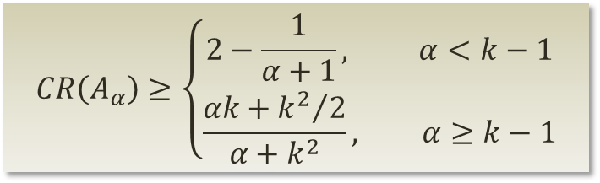
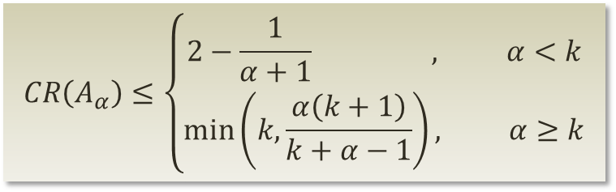
Competitive Ratio of $A_{α}$
For any conservative or marking A
$$CR\left(A_{α}\right)≥\left\{\begin{aligned}2−\frac{1}{α+1}, α<k−1 \\ &\frac{αk+{k^{2}}/2}{α+k^{2}}, α≥k−1\end{aligned}\right.$$
$$CR\left(A_{α}\right)≤\left\{\begin{aligned}2−\frac{1}{α+1} , α<k \\ &\min\left(k,\frac{α\left(k+1\right)}{k+α−1}\right), α≥k\end{aligned}\right.$$
k = 10

Slide 20

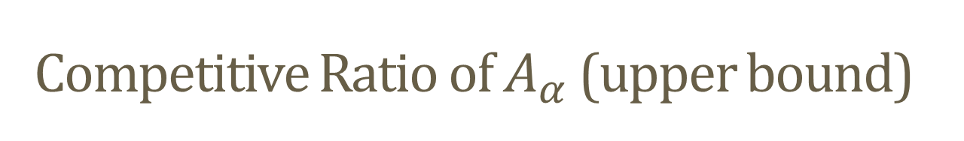
Competitive Ratio of $A_{α}$ (upper bound)
Case $α>k$

Slide 21




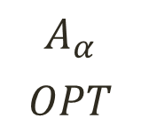

Competitive Ratio of $A_{α}$ (upper bound)
Case $α>k$
$$A_{α}$$
$$OPT$$
$$\frac{α\left(k+1\right)}{k+α−1}$$
$$\max{ 2,}$$
$$\min{}$$
$$≤$$
$$,k$$

Slide 22
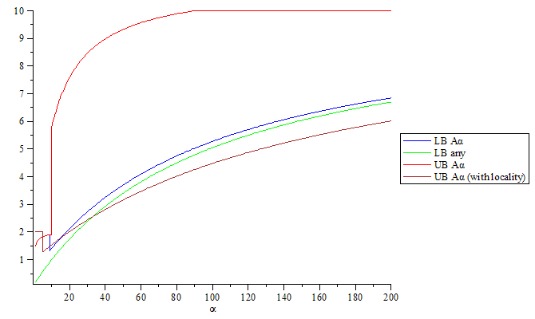
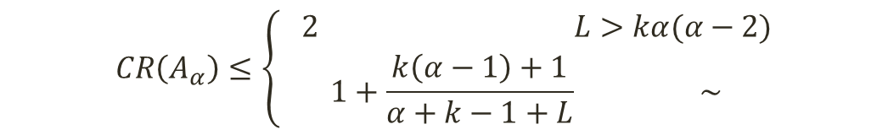
Locality of Reference
L = Average length of phase in k-phase partition
$$CR\left(A_{α}\right)≤\left\{\begin{aligned} 2 L>kα(α−2) \\ 1+\frac{k\left(α−1\right)+1}{α+k−1+L} \sim \end{aligned}\right.$$
k = 10
L = 150

Slide 23
Simulations

Slide 24
Cost Ratio k=5

Slide 25
Cost Ratio k=7

Slide 26
Faults

Slide 27
Average Cache Usage

Slide 28
Conclusions
Introduced Minimum Cache Usage problem
Cost-sensitive family of online algorithms
  2 ≤ CR(α) ≤ k
  2-competitive for sequences with high locality
Polynomial time optimal offline algorithm
Algorithms are competitive in practice
Future Work:
  Deeper lower bound analysis
  Other online algorithms
  Applications, e.g., shared cache cooperative strategy
Thank you

Slide 29
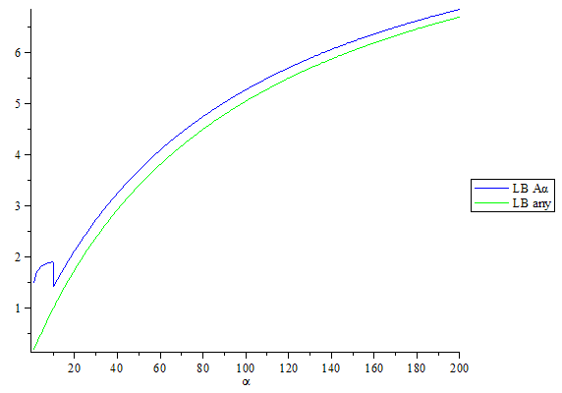
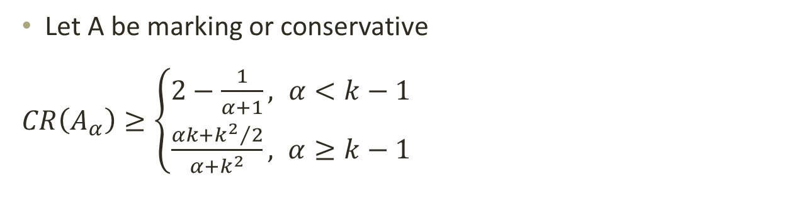
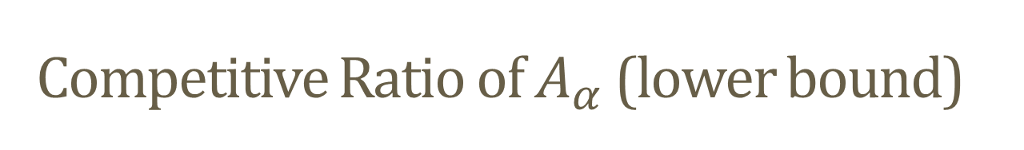
Competitive Ratio of $A_{α}$ (lower bound)
Let A be marking or conservative
$CR\left(A_{α}\right)≥\left\{\begin{aligned}2−\frac{1}{α+1}, α<k−1 \\ &\frac{αk+{k^{2}}/2}{α+k^{2}}, α≥k−1\end{aligned}\right.$
k = 10

Slide 30
Paging
Hit!
Cache
1
5
8
13
11
3
14
3
7
9
10
3
15
4
21
17
19
24
18
30
22
2
Memory
Memory

Slide 31
Paging
Fault!
Cache
1
5
8
13
11
6
14
3
7
9
10
15
4
21
6
17
19
24
18
30
22
2
Memory
6

Slide 32
Paging
Input:
sequence of page requests
cache size k
Paging algorithm = eviction policy
What page should be evicted from the cache?
Traditional cost model
Hit: 0
Fault: 1
Goal: minimize the number of faults

Slide 33
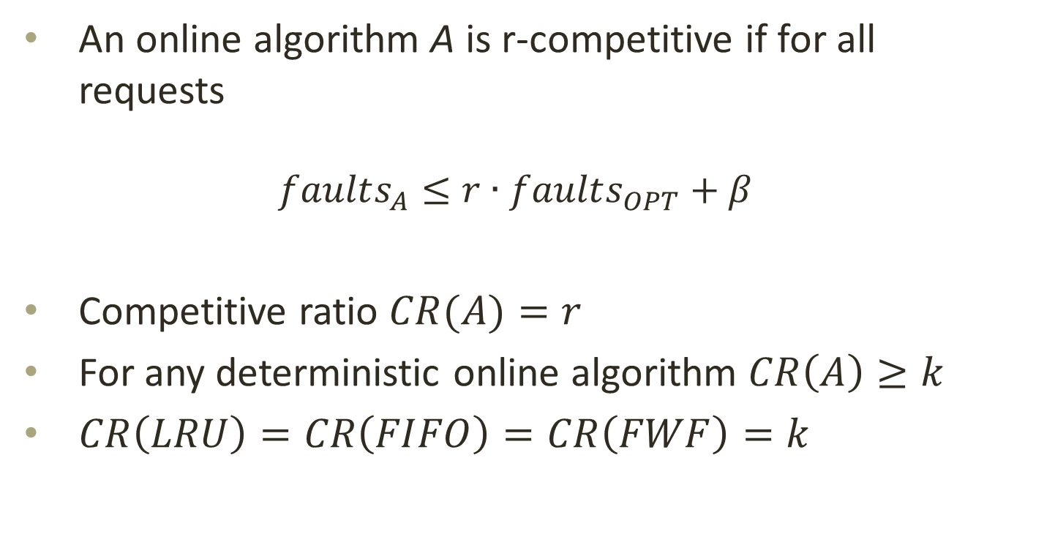
Competitive Analysis
An online algorithm A is r-competitive if for all requests
  $$faults_{A}≤r∙faults_{OPT}+β$$
Competitive ratio $CR(A)=r$
For any deterministic online algorithm $CR\left(A\right)≥k$
$CR\left(LRU\right)=CR\left(FIFO\right)=CR\left(FWF\right)=k$

Slide 34
Paging Models
Page has fault cost and size
Page fault (classic) model
  Uniform size and fault costs
Weighted caching [Chrobak 91]
  Varying fault costs, uniform page sizes
Fault model [Irani 97]
  Varying sizes, uniform fault cost
Bit model [Irani 97]
  Fault cost equals size
General [Young 98]
k-competitive algorithms for all above
Offline problem is NP-hard

Slide 35
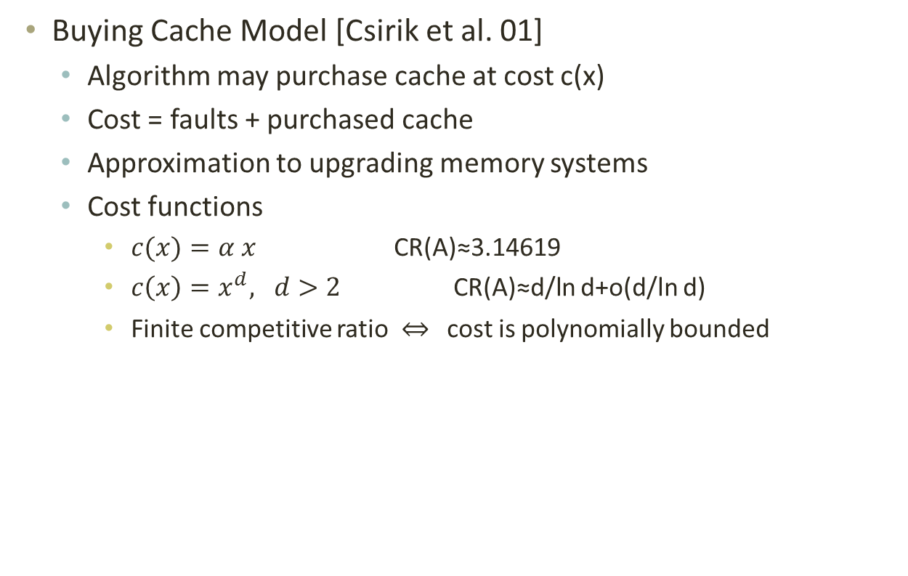
Paging Models
Buying Cache Model [Csirik et al. 01]
  Algorithm may purchase cache at cost c(x)
  Cost = faults + purchased cache
  Approximation to upgrading memory systems
  Cost functions
    $c(x)=α x$ CR(A)≈3.14619
    $c\left(x\right)=x^{d}, d>2$ CR(A)≈d/ln d+o(d/ln d)
    Finite competitive ratio cost is polynomially bounded

Slide 36
Offline Optimum
But paging is an online problem!
Offline algorithm can lead to good online algorithms
Classic paging optimum: FITF
LRU
…,3,3,4,5,21,3,4,17,5,3,5,5,6,7,8,9,6,7,4,4,5,3,15,13,3,3,7,8,9,…
…,3,3,4,5,21,3,4,17,5,3,5,5,6,7,8, ???
8,7,6,5,5,3,5,17,4

Slide 37
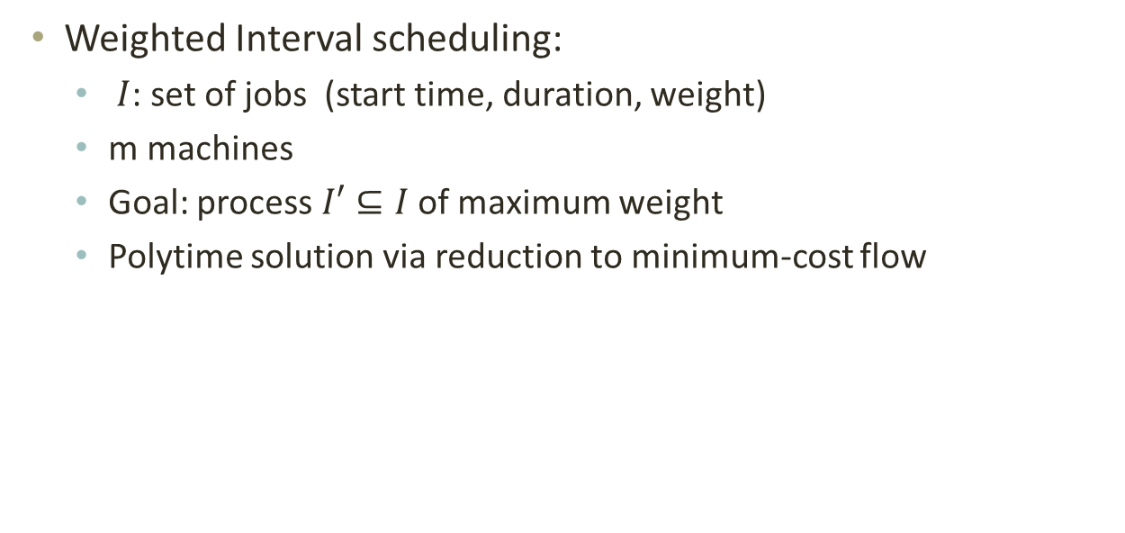
Interval Scheduling
1 | 2 | 3 | 4 | 1 | 1 | 3 | 5 | 2 | 3 | 4 | 5 | 1 | 2
1 | 2 | 3 | 4 | 1 | 1 | 3 | 5 | 2 | 3 | 4 | 5 | 1 | 2
Weighted Interval scheduling:
  $I$: set of jobs (start time, duration, weight)
  m machines
  Goal: process $I′⊆I$ of maximum weight
  Polytime solution via reduction to minimum-cost flow

Slide 38
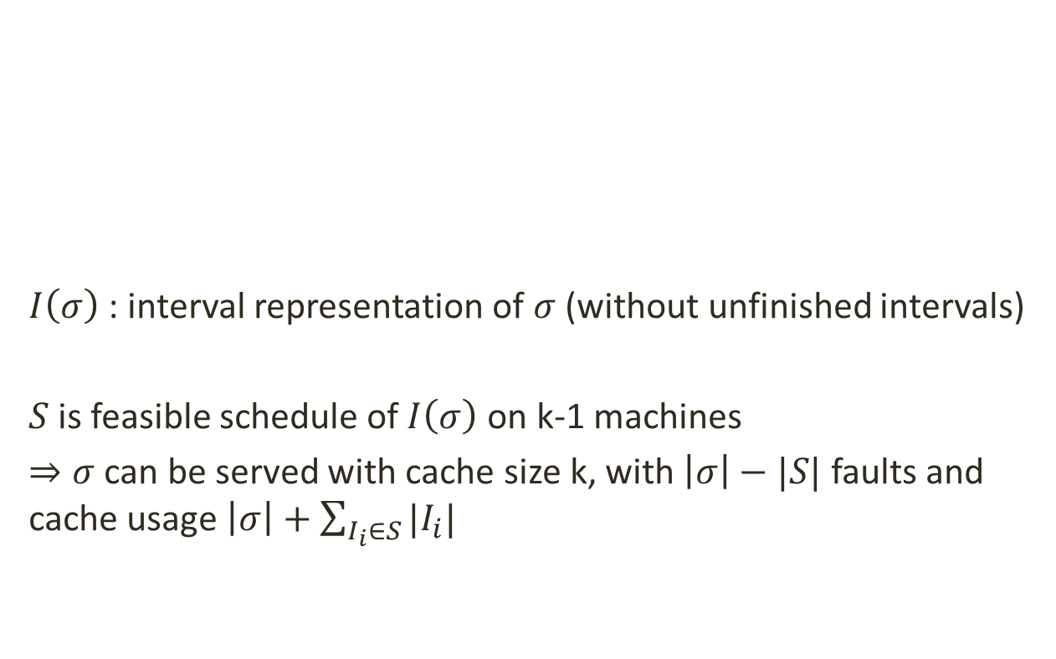
Interval Scheduling
$I\left(σ\right)$ : interval representation of $σ$ (without unfinished intervals)
$S$ is feasible schedule of $I\left(σ\right)$ on k-1 machines
$⇒σ$ can be served with cache size k, with $\left|σ\right|−|S|$ faults and cache usage $\left|σ\right|+\sum_{I_{i}∈S}{|I_{i}|}$
1 | 2 | 3 | 4 | 1 | 1 | 3 | 5 | 2 | 3 | 4 | 5 | 1 | 2

Slide 39
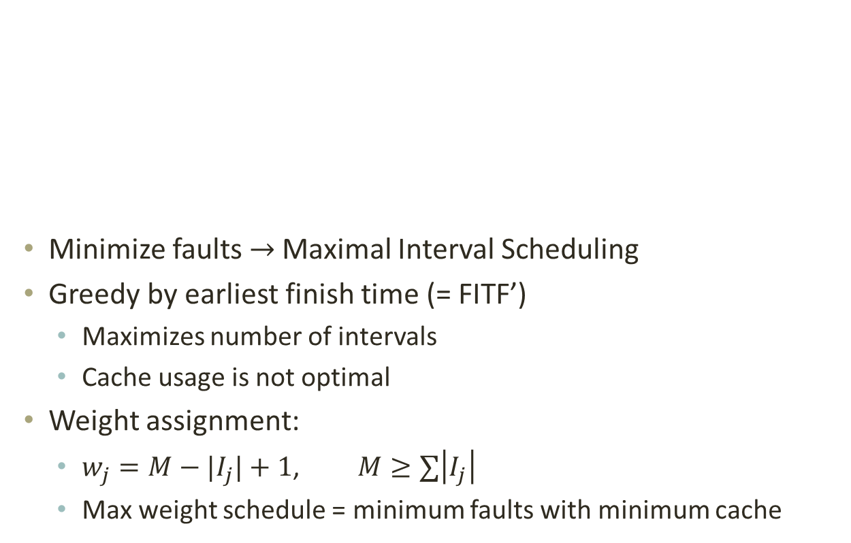
Interval Scheduling
Minimize faults $→$ Maximal Interval Scheduling
Greedy by earliest finish time (= FITF’)
  Maximizes number of intervals
  Cache usage is not optimal
Weight assignment:
  $w_{j}=M−|I_{j}|+1$, $M≥∑\left|I_{j}\right|$
  Max weight schedule = minimum faults with minimum cache
1 | 2 | 3 | 4 | 1 | 1 | 3 | 5 | 2 | 3 | 4 | 5 | 1 | 2

Slide 40
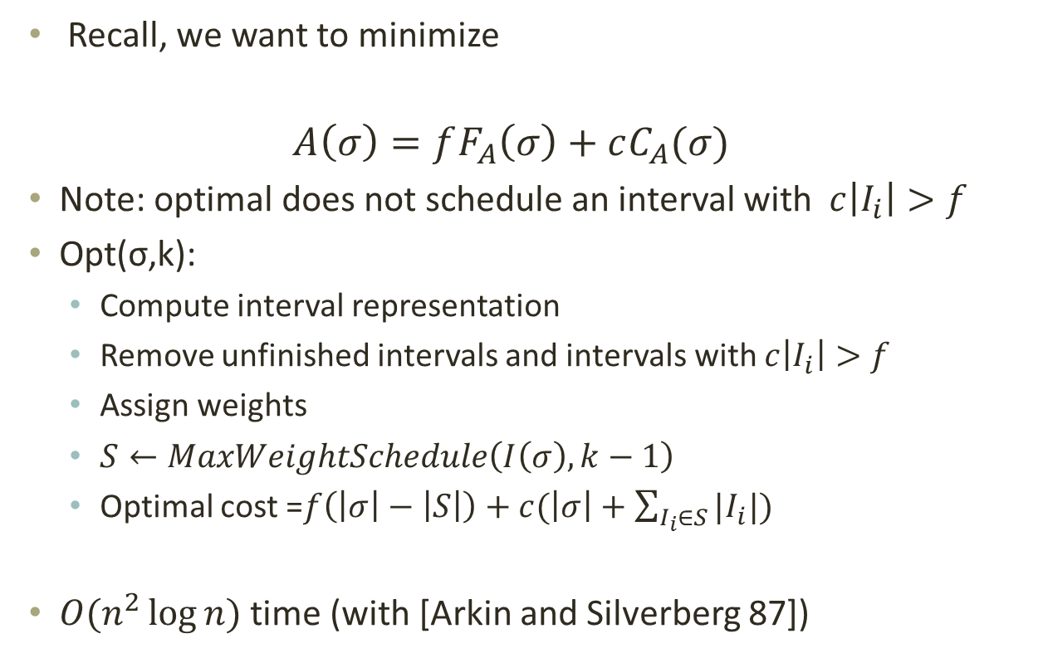
Offline Optimum
Recall, we want to minimize
$$A\left(σ\right)=fF_{A}\left(σ\right)+cC_{A}(σ)$$
Note: optimal does not schedule an interval with $c\left|I_{i}\right|>f$
Opt(σ,k):
  Compute interval representation
  Remove unfinished intervals and intervals with $c\left|I_{i}\right|>f$
  Assign weights
  $S←MaxWeightSchedule\left(I\left(σ\right),k−1\right)$
  Optimal cost =$f\left(\left|σ\right|−\left|S\right|\right)+c(\left|σ\right|+\sum_{I_{i}∈S}{|I_{i}|)}$
$O(n^{2}\log{n})$ time (with [Arkin and Silverberg 87])

Slide 41
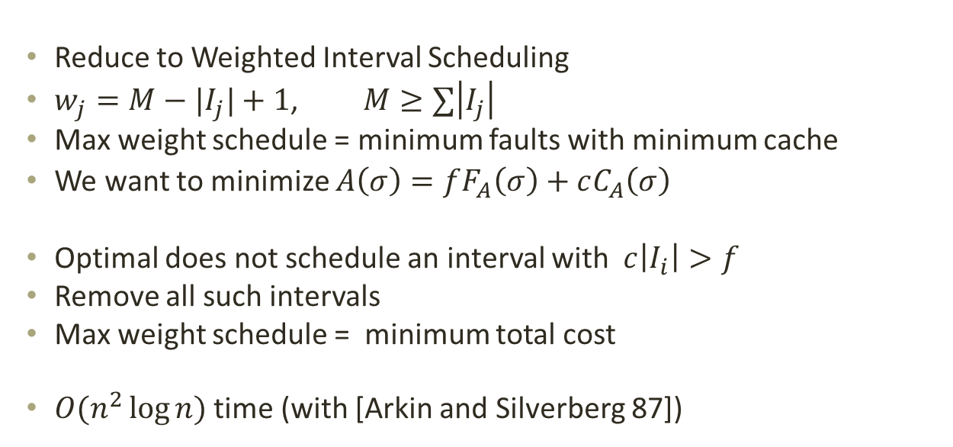
Offline Optimum
1 | 2 | 3 | 4 | 1 | 1 | 3 | 5 | 2 | 3 | 4 | 5 | 1 | 2
Reduce to Weighted Interval Scheduling
$w_{j}=M−|I_{j}|+1$, $M≥∑\left|I_{j}\right|$
Max weight schedule = minimum faults with minimum cache
We want to minimize $A\left(σ\right)=fF_{A}\left(σ\right)+cC_{A}\left(σ\right)$
Optimal does not schedule an interval with $c\left|I_{i}\right|>f$
Remove all such intervals
Max weight schedule = minimum total cost
$O(n^{2}\log{n})$ time (with [Arkin and Silverberg 87])

Slide 42
Online Algorithms
≤ k
≤ k
≤ k
≤ k
≤ k
≤ k distinct pages
Marking algorithm: at most k faults in each phase
  LRU, FWF, CLOCK
Conservative algorithm: at most k faults
  LRU, FIFO, CLOCK
≤ k distinct pages

Slide 43



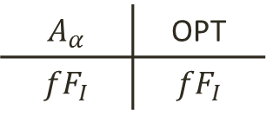

Competitive Ratio of $A_{α}$ (upper bound)
(2) $α≥k$
$$A_{α}$$ | OPT
$${fF}_{I}$$ | $${fF}_{I}$$
$$\frac{A_{α}}{OPT}≤k$$
$$fk$$ | $$f$$
$$cmk$$ | $$cm$$

Slide 44
Competitive Ratio of $A_{α}$ (upper bound)

Slide 45


Competitive Ratio of $A_{α}$ (upper bound)
Case $α>k$

Slide 46
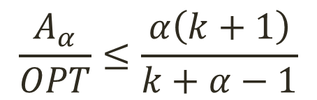
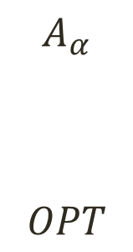
Competitive Ratio of $A_{α}$ (upper bound)
$$A_{α}$$
$$OPT$$
$$\frac{A_{α}}{OPT}≤\frac{α\left(k+1\right)}{k+α−1}$$

Slide 47



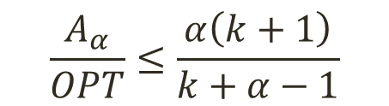
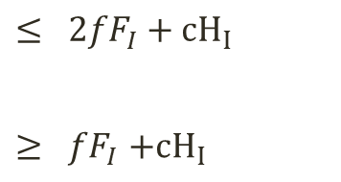
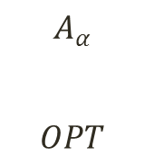

Competitive Ratio of $A_{α}$ (upper bound)
$$A_{α}$$
$$OPT$$
$$≤ {2fF}_{I}+{cH}_{I}$$
$${≥ fF}_{I}+{cH}_{I}$$
$$+ fF_{E}+{cH}_{E}$$
$$+ {c(E}_{f}+E_{h})$$
$$\frac{A_{α}}{OPT}≤\frac{α\left(k+1\right)}{k+α−1}$$
$$+ fF_{OPT}+{cH}_{E}$$
$$+ c({E_{h}+h}_{OPT})$$

Slide 48
Faults k=7

Slide 49
Average Cache Usage k=7

Slide 50
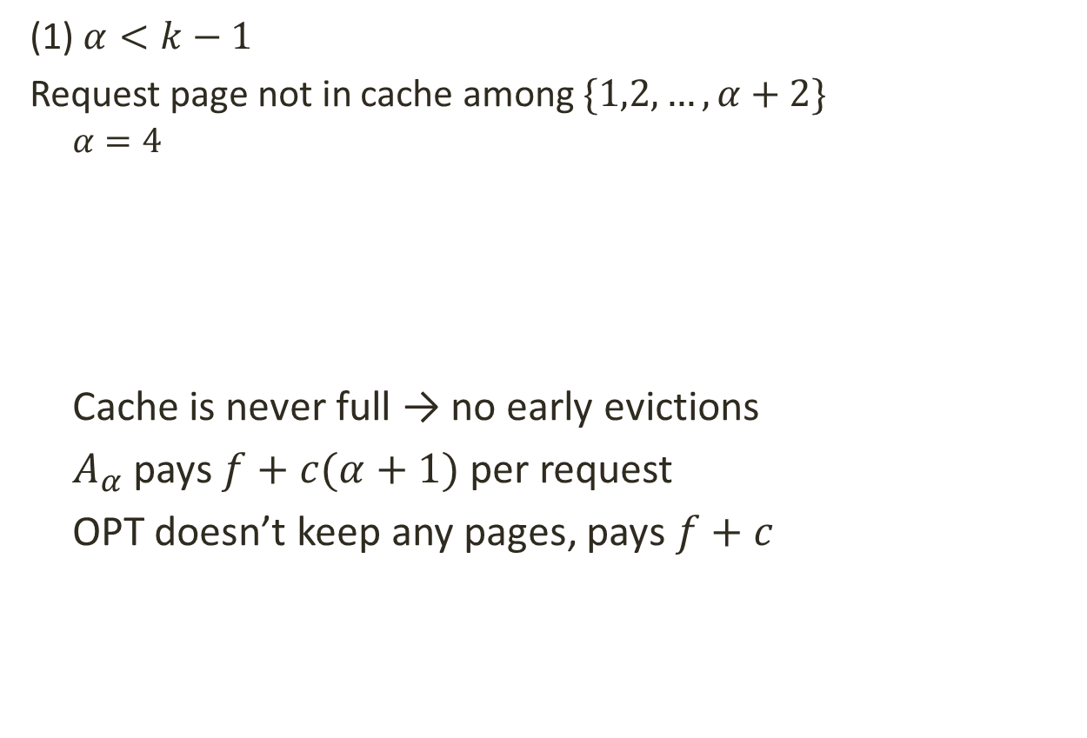
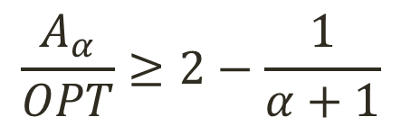

Competitive Ratio of $A_{α}$ (lower bound)
(1) $α<k−1$
Request page not in cache among $\{1,2,…,α+2\}$
  $$α=4$$
  Cache is never full → no early evictions
  $A_{α}$ pays $f+c(α+1)$ per request
  OPT doesn’t keep any pages, pays $f+c$
… | 1 | 2 | 3 | 4 | 5 | 6 | 1 | 2 | 3 | 4 | …
  $$α$$
$$\frac{A_{α}}{OPT}≥2−\frac{1}{α+1}$$

Slide 51

Competitive Ratio of $A_{α}$ (lower bound)
(2) $α>k−2$
Request page not in cache among $\{1,2,…,k+1\}$
  … …
  In phase:
  $A_{α}$: k faults, at least $\frac{k\left(k+1\right)}{2}$ cache
  OPT keeps k pages and faults once: 1 fault, $k^{2}$ cache
  $$\frac{A_{α}}{OPT}≥\frac{αk+{k^{2}}/2}{α+k^{2}}$$
  k = 9
4 | 3 | 1 | 6 | 7 | 5 | 8 | 9 | 2 | 0 | 6 | 2 | 3 | 1

